Slide 1
How To Design a disease Model in Animal study
By Dr. Ghadeer Hamad

Slide 2
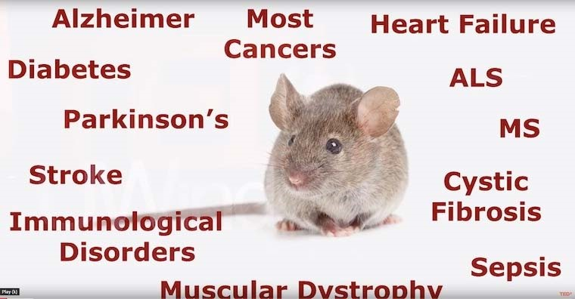

Slide 3
Introduction
Today animals models are used in every field of research in preclinical and clinical studies
New treatment modalities are tested in animals before they are administered to human
The physiological and anatomical similarity between human and animals have prompted researchers to examine a huge numbers of mechanisms and evaluate novel therapy in animal models before applying in human

Slide 4
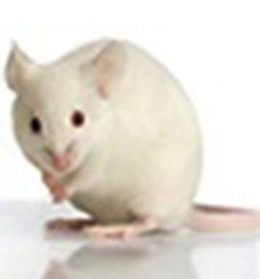
Why Animals??
An animal model is a non-human species used in medical research because it can mimic aspects of a disease found in humans without the risk of harming a human.
Animal models are used to obtain information about a disease and its prevention, diagnosis, and treatment.

Slide 5
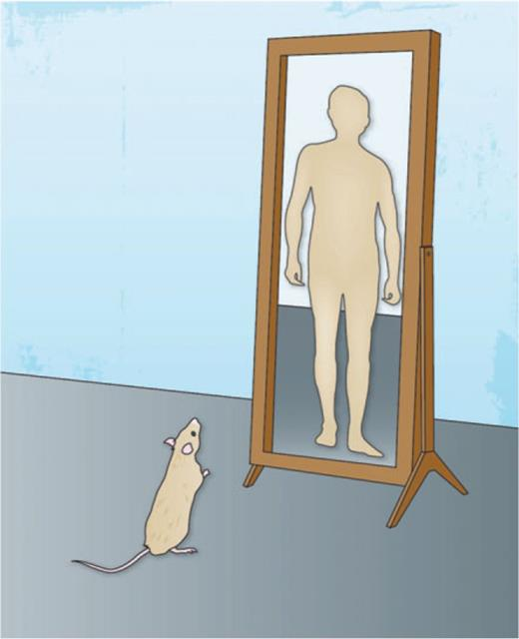
Type of Animals used

Slide 7
How to design groups in animal study
At first we need to involve a control group to rule out alternative explanations of the experimental results.

Slide 8
Animal model for Gastric ulcer
Group1 receive DW for 7 days as negative control group
Group2 receive protective compound (1)dissolved in D.W---Test
Group3 receive protective compound (2)dissolved in
D.W---Test
Group4 receive Ranitidine for 7 days as positive control group
Group 5 receive DW for 7 days as normal control

Slide 9
Cont.
On the 8th day and after 22 h fasting absolute ethanol (7 ml/kg) was administrated orally to all mice to induce the acute ulcer
Abdomen opened and ligatures placed around the esophagus and pylorus then consequently the stomach was excised for examination

Slide 10
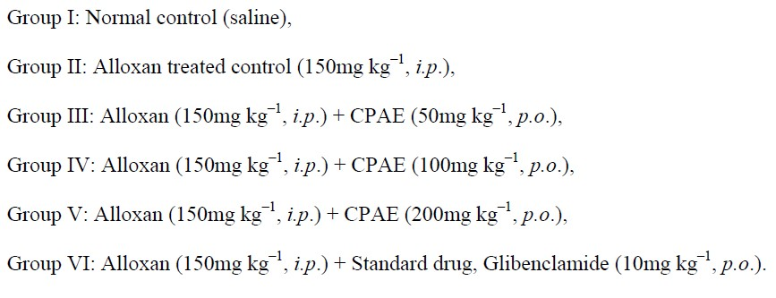
Experimental design and induction of diabetes in animals
Negative control
Positive control

Slide 11
Animal model for Hypothyroidism
Group1 receive normal drinking water serve as control
Group2 receive protective compound M. communis L. oil 200mg/kg by gavage
Group3 receive protective compound M. communis L. oil 400mg/kg by gavage
Group4 receive 0.05% PTU was added to drinking water to induce HypoT.
Group 5 receive 0.05% PTU was added to drinking water+ M. communis L. oil 200mg/kg
Group 6 receive 0.05% PTU was added to drinking water+ M. communis L. oil 400mg/kg

Slide 13
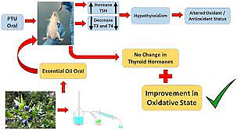

Slide 14
Animal model for Hyperthyroidism
Group1 normal control receive vehicle
Group2 receive Levothyroxine 100µg/kg for induction of HyperT
Group3 Levothyroxine 100µg/kg +test compound
Scarified after 6 weeks treatment

Slide 15
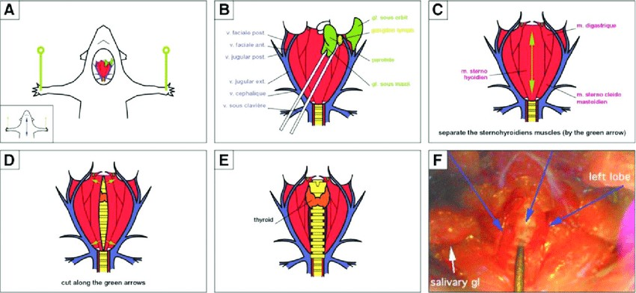

Slide 16
Animal model for Asthma
Group1 served as normal control (sensitized with saline)
Group2 served as asthma control (challenged with OVA) Negative control
Group3 receive protective compound +OVA sensitization as experimental test group
Group4 prednisolone + OVA sensitization as positive control group

Slide 17
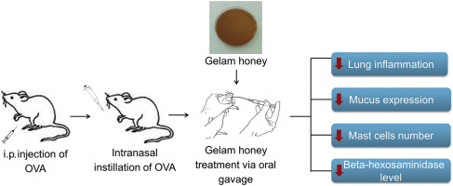

Slide 18
Hyperlipidemia model
Group1 Rats in the control group were fed with common diet
While the other groups were fed with high-fat diet for six weeks to establish hyperlipidemia disorder animal models
Blood lipid level of rats were determined whether the model was successful

Slide 19
Hyperlipidemia model
Group1 Hyperlipidemic + Placebo Negative control
Group2 Hyperlipidemic+ Simvastatin Positive control
Group3 Hyperlipidemic+ Test compounds
Group4 Normal control
Treatment for 14 days

Slide 20
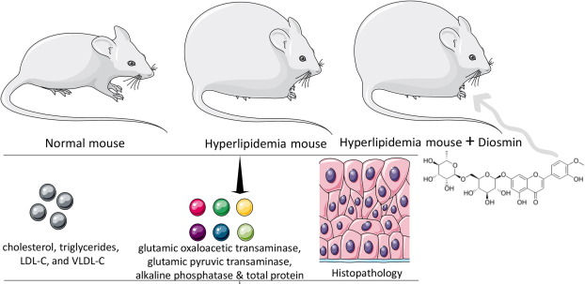

Slide 21
Nephrotoxicity in Rats
Group1(control): will receive oral distal water (1ml) for 7 days ,then receive normal saline (1ml) I.P. injection on day 7.
Group2 will receive oral distal water (1ml) for 7 days ,then receive amikacin dose (1.2 g /kg ) single dose I.P. injection on day 7 .
Group 3: will receive oral extract for 7 days , then receive amikacin dose (1.2 g /kg ) single dose I.P. injection on day 7.

Slide 22
Arthritic gout model
Group1 Oral vehicle for 1 days before gout induction as Negative control
Group2 Oral colchicine (30 mg/kg) 1 day before gout induction as Positive control
Group 3crude extract (100 mg/kg) 1 day before gout induction
Group4 crude extract (300 mg/kg) 1 day before gout induction
Group5 Oral vehicle for 1 days as Normal control • injected of vehicle (PBS) or MSU suspension (1.25 mg/site)to the tibio–tarsal joint (ankle) on isoflurane anesthetized animals.

Slide 23
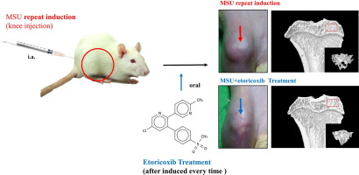

Slide 24
Transgenic mouse model
The benefits of using transgenic mouse model to test a hypothesis about disorders affected by genetics.
They allow researcher to test potential drug treatments more readily and get results much faster.
Moreover, in some instance, there are diseases that have unknown causes, and transgenic mice are useful for investigating specific aspect of these disorders.

